Slide 1
4
Excitons
4.1 The concept of excitons
4.2 Free excitons
4.3 Free excitons in external fields
4.4 Free excitons at high densities
4.5 Frenkel excitons

Slide 2
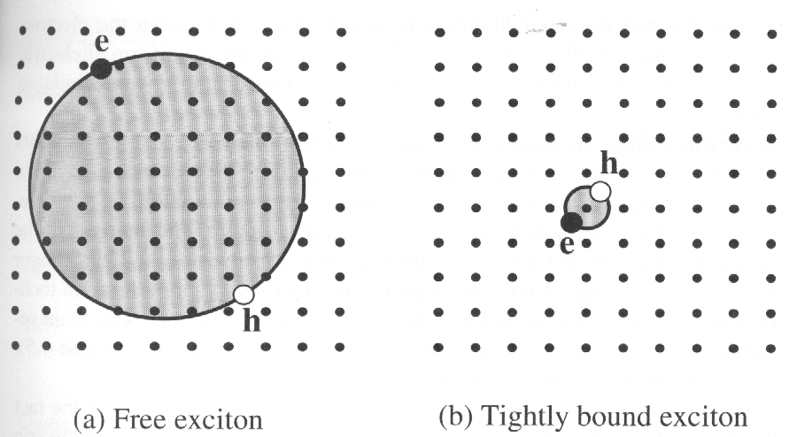
4.1 The concept of excitons
Exciton: bound electron – hole pair
Two basic types:
Wannier – Matt excitons (free exciton): mainly exist in semiconductors, have a large radius,
are delocalized states that can move freely throughout the crystal,
the binding energy ~ 0.01 eV;
Frenkel excitons (tight bound excitons): found in insulator and molecular crystals, bound to
specific atoms or molecules and have to move by hopping from one
atom to another, the binding energy ~ 0.1 -1 eV.
The maximum energy of a thermally excited phonon ~ k_{B}T = 0.025 eV (RT)
Wannier – Matt excitons:
stable at cryogenic temperature.
Frenkel excitons:
stable at room temperature.
General properties:
(补充)

Slide 3
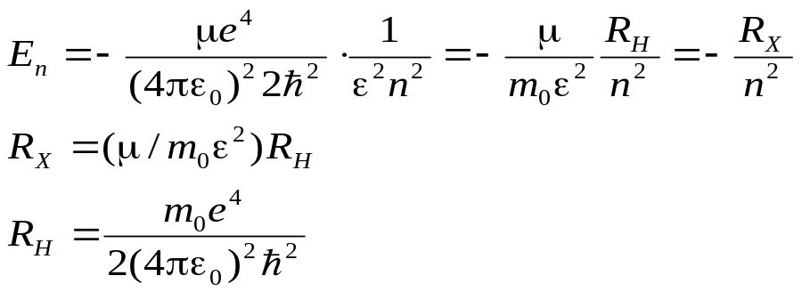
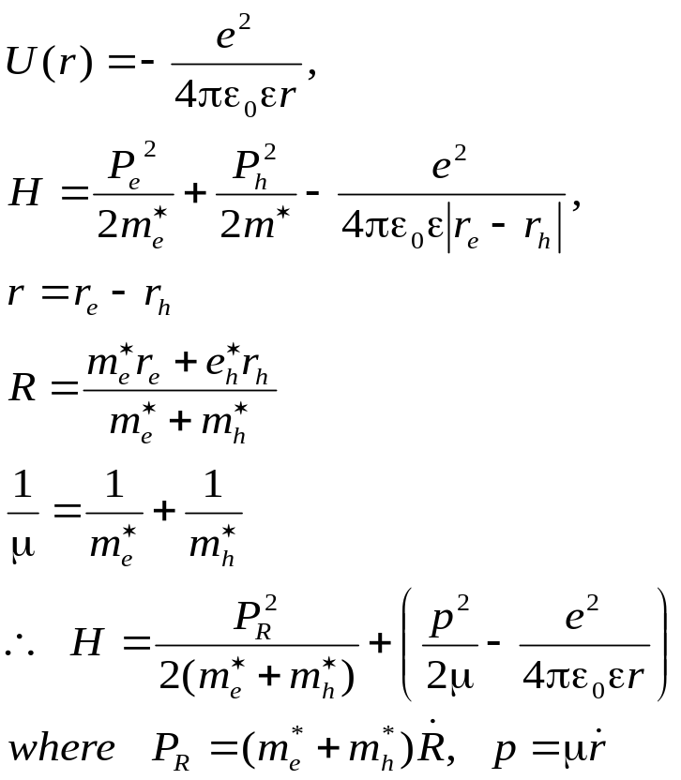
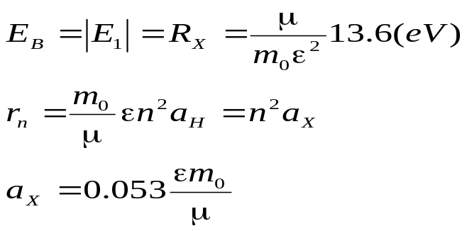
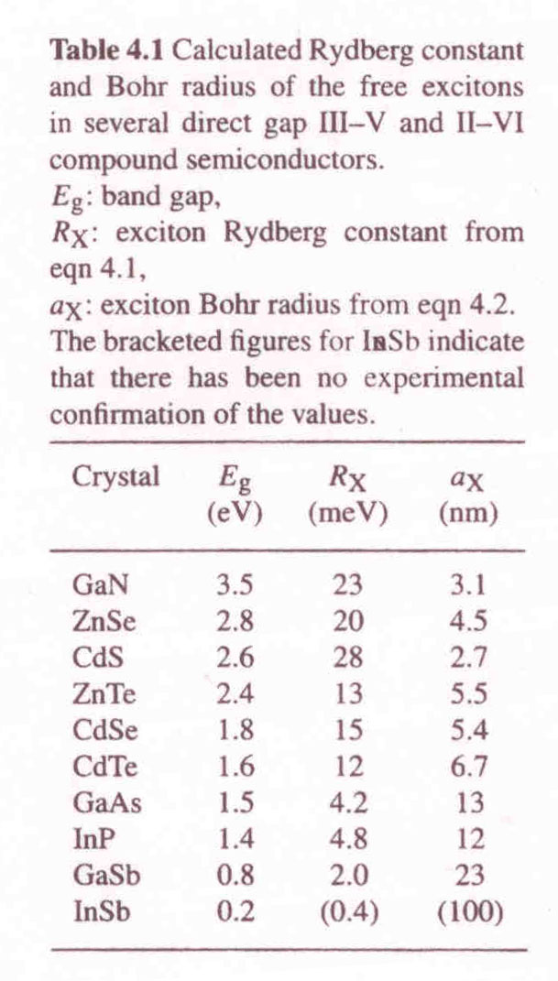
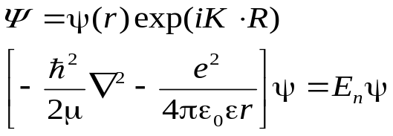
4.2 Free excitons
4.2.1 Bing energy and radius
(Exciton Rydberg constant)
The binding energy and radius of exciton:
(Exciton Bore radius)
Table 4.1
The eigenfunction and eigenvalue eq:

Slide 4
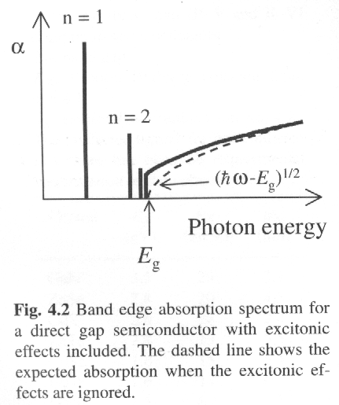
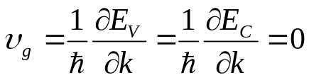
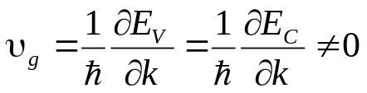
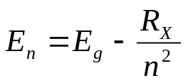
4.2.2 Exciton absorption
Creating an electron-hole pair -> the same k vector;
Creating an exciton -> the same group velocity.
(high symmetry points)
(high symmetry lines)
At the zone centre: k=0 and zero gradient, strong excitons occur in the spectral region close to the fundamental band gap. The energy of exciton is:
Strong optical absorption line at energies equal to E_{n} that appear in the spectra at energies just below the fundamental band gap
Free excitons can only be observed in the absorption spectrum of very pure samples, because impurities release free elecrons and holes that can screen the Coulomb interaction in the exciton and thereby strongly reduce the binding froces.

Slide 5
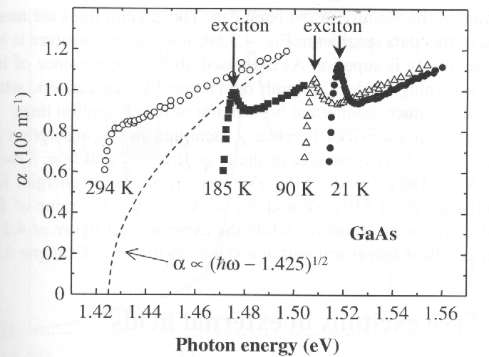
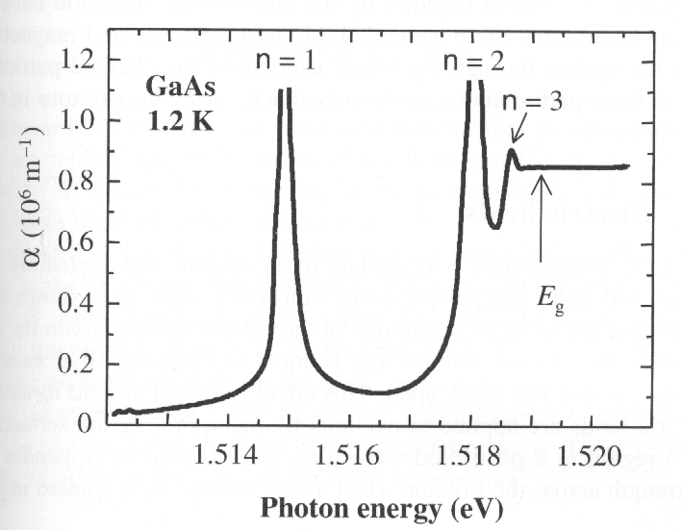
4.2.3 Experimental data for free exciton in GaAs
(a) The dissociation of exciton is mainly caused
by collision with longitudinal optic (LO) phonons;
The Coulomb interaction between the electron and hole still enhances the absorption rate considerably.
(b )
(a )
Excitonic ansorption of GaAs among 21 K and 294 K. The dashed line is an attempt to fit the absorption edge with a value of E_{g} equal to 1.425 eV which is appropriate for GaAs at 294 K
Excitonic absorption of ultra pure GaAs at 1.2 K. The data clearly show the hydrogen-like energy spectrum of the exciton in the vicinity of the band gap. The energies of the n=1, n=2, and n=3 excitons are 1.5149, 1.5180 and 1.5187 eV respectively. E_{g}=1.5191 eV and R_{X} =4.2 meV can be fitted from these data.

Slide 6
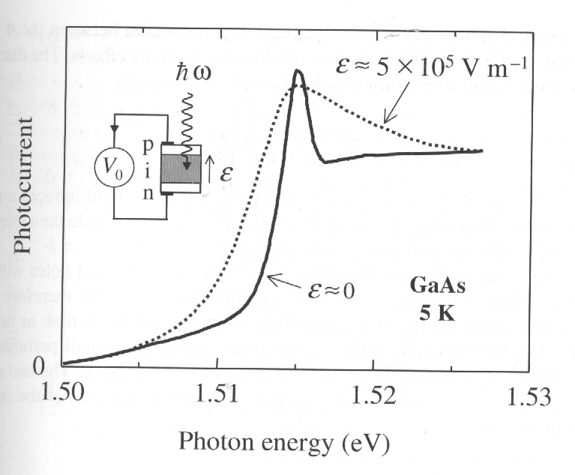
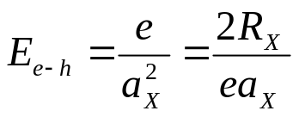
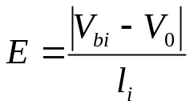
4.3 Free excitons in external fields
4.3.1 Electric fields
A DC field can push the oppositely charged electrons and holes away from each other.
The electric field between electron and hole in the ground state exciton:
≈ 6×10⁵ V/m
Field ionization as E > E_{e-h,} then the exciton will break apart.
V_{bi}: the build-in voltage ≈ 1.5V;
L_{i}: the intrinsic region thickness ≈ 1um;
E = 1.5 ×10⁶ V/m.
The excitons will be ionized before the bias applied
Field ionization of the free excitons in GaAs at 5 K. The data was taken on a GaAs p-i-n diode with an i-region thickness of 1 μm. The solid corresponds to ‘ flat band’(forward bias of +1.00V, where E ≈ 5 ×10⁵ V/m. No exciton lines are resolved at zero bias.
The physics effect of bulk semiconductors in field is dominated more by the effect of the field on the band states—the Franz-Keldysh effect, rather than by the exciton effect.

Slide 7
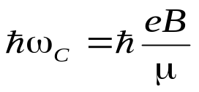
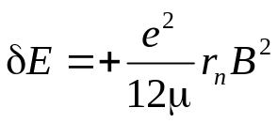
4.3.2 Magnetic fields
The cyclotron energy of excitation in magnetic fields:
Two field regimes:
Weak field limit: R_{X} >>hω_{C} (< 2T)
Strong field limit: R_{X} << hω_{C} (> 2T).
Weak field:
For n=1, the exciton has no net magnetic moment due to spherical symmetry – diamagnetic effect. Energy shift:
Strong field:
The interaction between electrons and holes is stronger than their mutual Coulomb interaction. Therefore consider the Landau energy of the individual electrons and holes first, and add on the Coulomb interaction as a small perturbation.

Slide 8
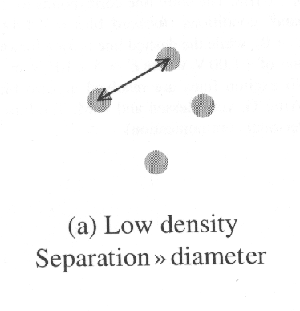
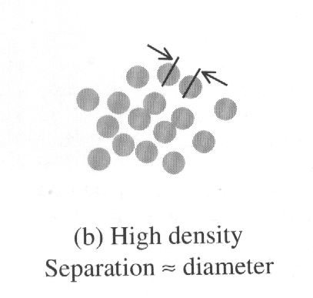
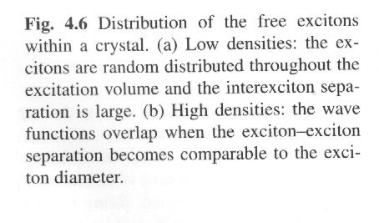
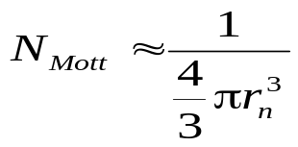
4.4 Free excitons at high densities
The laser can create excitons in the sample with a density that is proportional to laser power.
Mott density at which exciton wave function overlap occurs:
N_{Mott}=1.1×10²³m⁻³ for GaAs, n=1. This is easily achievable with a focused laser beam.

Slide 9
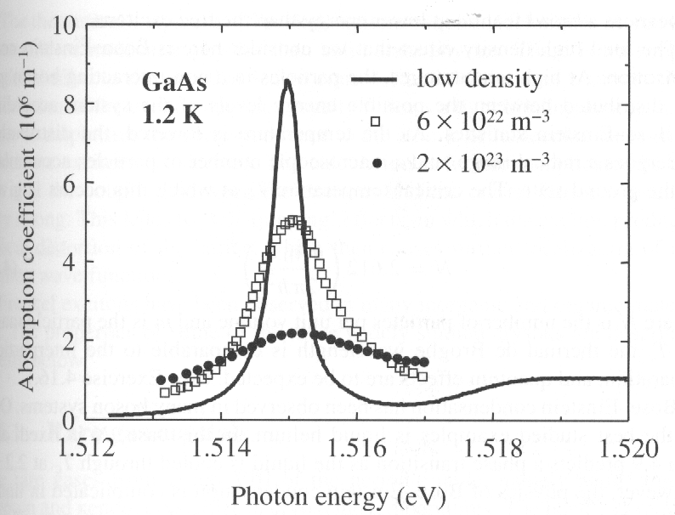
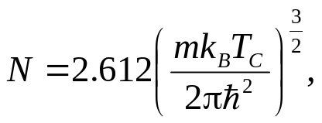
4.4 Free excitons at high densities
When the exciton density approaches N_{Mott,}, a number of effects can occur.
Effect 1: electron- hole plasma
The collisions between cause the exciton gas to dissociate into an electron-hole plasma.
Effect 3: electron- hole droplets
In silicon and germanium, as the density increases,
the excitons condense to form a liquid, which are observed in the recombination radiation of the excitons at high densities
Effect 4: Bose-Einstein condensation
Excitons consist of two spin ½ particles, and so their total spin is either 0 or 1. they are bosons, therefore there have been many attempts to study condensation phenomena. In theory, the critical temperature T_{C} at which this occurs is given by:
Absorption coefficient of GaAs in the spectral region close to the band edge at 1.2 K at three different excitation powers. The saturation of the exciton absorption with increasing power is a kind of nonlinear optical effect.
Effect 2: biexcitons
High exciton density tends to form exciton mole- cules called biexcitons. (CdS, ZnSe, ZnO, CuCl…)
At Tc the thermal de Broglie wavelength is compar- able to the interparticle separation, and quantum effects are to be expected.
Two of the most promising candidate systems that have been studied to date are the spin-0 excitons in Cu₂O and the biexcitons in CuCl. However, It is actually very difficult to prove definitively that condensation has occurred

Slide 10
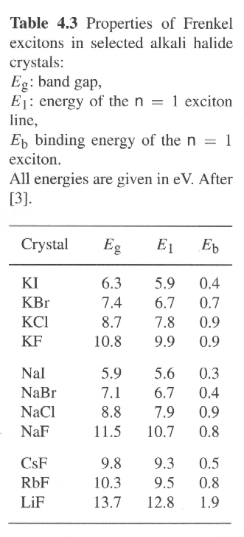
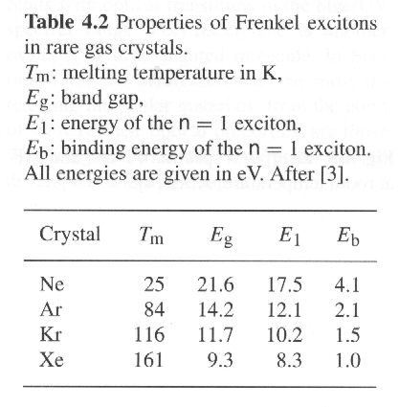
4.5 Frenkel excitons
Frenkel excitons are localized on the atom site at which they are created. They have very small radii and correspondingly large binding energies, with typical values ranging from about 0.1 eV to several eV. They usually stable at room temperature and can propagate through the crystal by hopping from atom site to site in the same way that spin excitation propagate through crystals as magnon waves.
4.5.1 Rare gas crystals
4.5.2 Alkali halides
The group VIII of the periodic table
Large direct band gaps in UV spectral region ranging from 5.9 eV to13.7 eV.
The excitons are localized at the negative (halogen) ions.
There is a close correspondence between the exciton energies and the optical transitions of the isolates atoms.

Slide 11
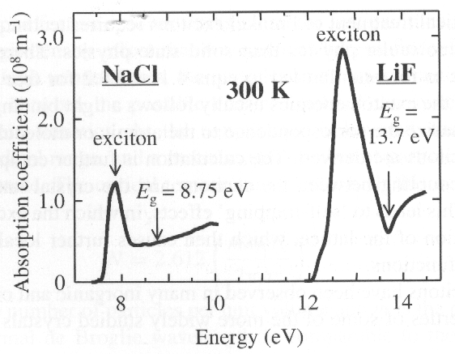
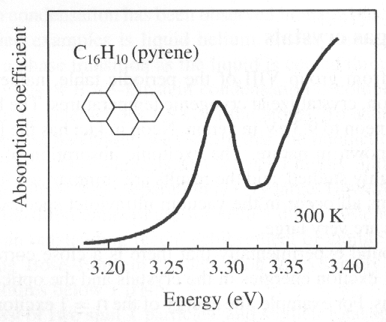
4.5.2 Alkali halides
4.5.2 Molecular crystals
Frenkel excitons can be observed in many molecular crystals and organic thin film structure. In most cases, there is a very strong correspondence between the optical transitions of the isolated molecules and the exciton observed in the solid state.
Frenkel excitons are also very important in conjugated polmers, such as polydiacetylene (PDA) etc.
Absorption spectra of NaCl and LiF at RT. The binding energies are 0.8 eV and 1.9 eV, respec- tively. Note that the absorption coefficient at the exciton lines is extremely large, with the values over 10⁸ m⁻¹in both materials.
Absorption apectrum of pyrene (C₁₆H₁₀) single crystal in RT

Slide 12
Exercises:
i) Calculate the exciton Rydberg and Bohr radius for GaAs, which has ε_{r} =12.8, m_{e}* = 0.067 m₀ and m_{h}*=0.2m₀.
ii) GaAs has a cubic crystal structure with a unit cell size of 0.56 nm. Estimate the number of unit cells contained within the orbit of the n=1 exciton. Hence justify the validity of assuming that the medium can be treated as a uniform dielectric in deriving eqns E(n)= -R_{X}/n² and r_{n}=n²a_{X}.
iii) Estimate the highest temperature at which it will be posible to observe stable exciton in GaAs.
Calculate the diamagnetic energy shift of the n =1 exciton of GaAs in a magnetic field of 1.0 T. What is the shift in the wavelength of the exciton caused by applying the field? Take μ = 0.05 m₀, and the energy of the exciton at B=0 to be 1.515 eV.
Show that the de Broglie wavelength λ_{deB} of a particle of mass m with thermal kinetic energy 3k_{B}T/2 is given by:
λ_{deB}= h / (3mk_{B}T)^{1/2}.
Calculate the ratio of the interparticle separation to λ_{deB} at the Bose-Einstein condensation temperature.

